Slide 1
Tax Help for Cannabis Retailers
Notes:
This presentation will cover an overview of the Cannabis Tax Law, Cannabis Excise Tax, and Sales and Use Tax. We will also go over the requirements for a cannabis retailer.

Slide 2
Get it in Writing!
This presentation illustrates general tax concepts and does not describe every situation. Email us at www.cdtfa.ca.gov/email/ with details specific to your business operations for legally-reliable written tax guidance.
Please note: The contents of these slides as well as answers provided in the chat during this presentation do not constitute written tax advice that may provide relief from liability under California Revenue and Taxation Code (R&TC) §6596 and §55045 and Regulation 1705.
Notes:
This presentation is to be used only as an aid to illustrate general tax concepts, but it does not address every situation. If you email us a request for written advice and provide us the details specific to your business operations, we can provide you with tax guidance you can rely on.
By putting your questions in writing, you may be protected from owing additional tax, interest, and penalties, should we furnish you with erroneous written advice. You are not afforded the same protections if you receive the information orally, in person, or over the telephone.
You may request written advice through the following webpage: www.cdtfa.ca.gov/email/
Note: The contents of these slides as well as answers provided in the “chat” during this presentation do not constitute written tax advice that may provide relief from liability under California Revenue and Taxation Code (R&TC) §6596 and §55045 and Regulation 1705.
If the presenter needs to discuss R&TC section 6596, the following is provided:
R&TC section 6596 - Excusable Delay-Reliance on Advice, states:
“If CDTFA finds that a person’s failure to make a timely return or payment is due to the person’s reasonable reliance on written advice from the CDTFA, the person may be relieved of taxes imposed by §6051 and §6201 and any penalty or interest added thereto.”
R&TC section 55045 states:
“If CDTFA finds that a person’s failure to make a timely report or payment is due to the person’s reasonable reliance on written advice from the board, the person may be relieved of the fees imposed or administered under this part and any penalty or interest added thereto.”

Slide 3
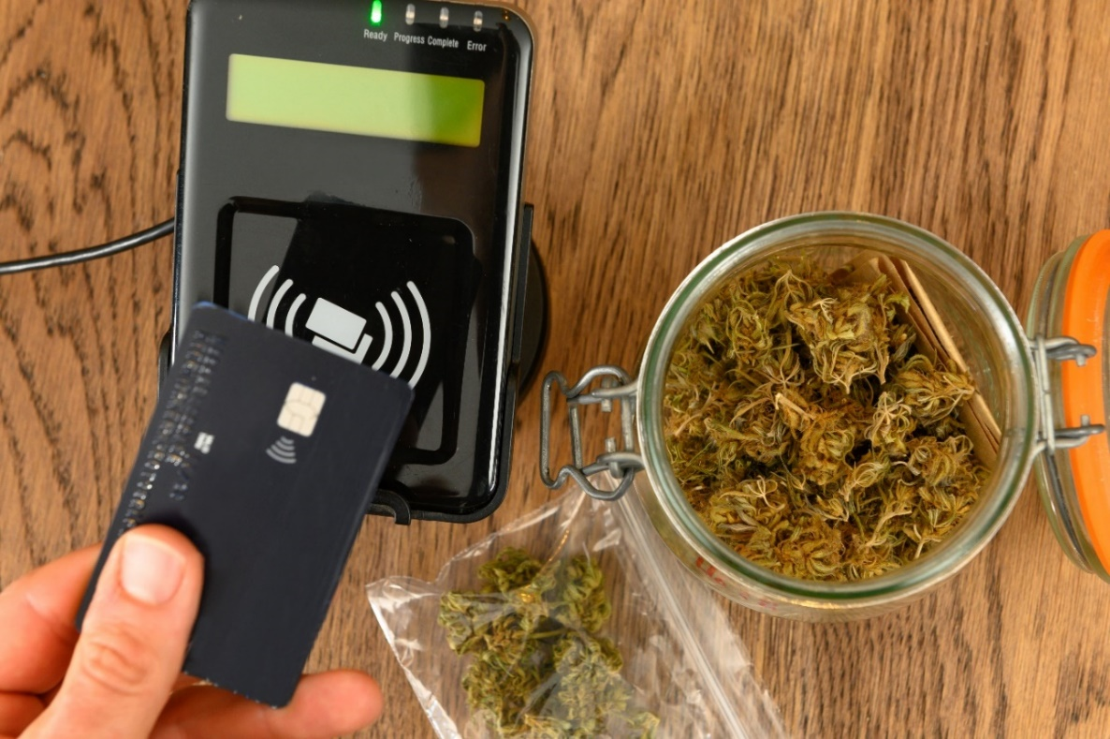
Cannabis Retailer
A cannabis retailer is a person who engages in retail sales or deliveries of cannabis or cannabis products to customers. This includes microbusinesses authorized to sell cannabis at retail.
Notes:
A cannabis retailer is a person required to be licensed by the Department of Cannabis Control to engage in the retail sale or delivery of cannabis or cannabis products to customers.
A microbusiness license authorizes the licensee to operate as more than one type of business as approved by DCC at the same licensed premises. A microbusiness that operates as a cannabis retailer is responsible for all the same requirements under the Cannabis Tax Law as a licensed cannabis retailer.

Slide 4
Cannabis Tax Law
November 8, 2016 – Under Proposition 64, voters approved legalizing adult use of cannabis.
June 30, 2022 – Cannabis tax reform under AB 195:
Ended the cultivation tax as of July 1, 2022.
Moves the collection and payment of the cannabis excise tax from the distributor to the cannabis retailer, for retail sales of cannabis or cannabis products made on and after January 1, 2023.
Notes:
Voters approved Proposition 64 on November 8, 2016. Proposition 64, which was later amended by Senate Bill 94, legalized adult-use of cannabis and established the Cannabis Tax Law.
On June 30, 2022, the Governor approved Assembly Bill 195 to simplify the cannabis tax structure and helps to reduce burdens for legal cannabis businesses. Some of the changes that we will go over in this presentation include: general information on shifting the requirement to report and pay the cannabis excise tax from the distributor to the cannabis retailer and the changes made to the Cannabis Tax Law.
The cannabis excise tax may increase from 15% beginning the 2025-2026 fiscal year and every 2 years after, not to exceed 19%. The rate may be adjusted by CDTFA in consultation with Department of Finance based on guidelines in the Cannabis Tax Law.
Reference: RTC 34011.2(a).

Slide 5
Cannabis Cultivation Tax Ends
Beginning January 1, 2018, through June 30, 2022:
The cultivation tax was imposed on all harvested cannabis that entered the commercial market.
Applied to cultivators of cannabis.
Cultivators were responsible for paying the cultivation tax to the distributor or to the manufacturer.
Notes:
The cultivation tax ended on June 30, 2022, due to the enactment of AB 195.
The cannabis cultivation tax was imposed on all harvested cannabis that entered the commercial market beginning on January 1, 2018, through June 30, 2022, upon all cultivators of cannabis.
Cannabis is considered to have entered the commercial market once it has completed and complies with a quality assurance review and testing as required by the Department of Cannabis Control.
When the cultivation tax was imposed, cultivators were responsible for paying the cultivation tax to a distributor, or in some cases, to a manufacturer if the cannabis was first transferred or sold to a manufacturer.

Slide 6
Cannabis Cultivation Tax Ends (continued)
On and after July 1, 2022:
The cultivation tax is no longer imposed on harvested cannabis that enters the commercial market.
Distributors, manufacturers, and cultivators are no longer required to collect or pay the cultivation tax.
Any cultivation tax collected on cannabis that enters the commercial market on and after July 1, 2022, must be returned to the cultivator that originally paid it.
If cultivation tax cannot be returned, it must be paid to CDTFA as excess cultivation tax collected.
Notes:
On and after July 1, 2022, cultivation tax is no longer imposed on harvested cannabis that enters the commercial market.
Distributors, manufacturers, and cultivators are no longer required to collect or pay the cultivation tax on harvested cannabis that enters the commercial market on and after July 1, 2022.
Any cultivation tax collected on cannabis that enters the commercial market on and after July 1, 2022, must be returned to the cultivator that originally paid it.
If the cultivation tax cannot be returned to the cultivator that paid the cultivation tax, then it must be paid to CDTFA as excess cultivation tax collected.
Distributors must report and pay any excess cultivation tax collected to CDTFA.
If a manufacturer has excess cultivation tax that cannot be returned to the cultivator, then the manufacturer must transfer the excess cultivation tax collected to a distributor for the distributor to report and pay the excess cultivation tax collected to CDTFA.

Slide 7
Cannabis Excise Tax
Beginning January 1, 2018, through December 31, 2022:
The Cannabis Tax Law imposes a 15 percent cannabis excise tax upon purchasers at the retail sale of cannabis or cannabis products.
Retailers are responsible for collecting the cannabis excise tax from purchasers at the time of the retail sale based on the average market price for retail sales of cannabis or cannabis products made before January 1, 2023.
Distributors are required to collect the cannabis excise tax from cannabis retailers for cannabis or cannabis products sold or transferred to a cannabis retailer before January 1, 2023.
Notes:
For the period beginning on January 1, 2018, through December 31, 2022, the Cannabis Tax Law imposes a 15 percent cannabis excise tax upon purchasers at the retail sale of cannabis or cannabis products.
Retailers are responsible for collecting the cannabis excise tax from purchasers at the time of retail sale based on the average market price of the cannabis or cannabis products sold in a retail sale before January 1, 2023.
Additionally, distributors are required to collect the cannabis excise tax from cannabis retailers for cannabis or cannabis products sold or transferred to a cannabis retailer before January 1, 2023, based on the average market price of cannabis or cannabis products sold in a retail sale.

Slide 8
Average Market Price – Applicable through December 31, 2022
January 1, 2018, through December 31, 2022:
Based on the type of transaction.
Arm’s length transaction
The average market price is the wholesale cost plus a mark-up.
Non-arm’s length transaction
The average market price is the cannabis retailer’s gross receipts from the retail sale.
Notes:
The average market price calculation applies to sales or transfers that occur through December 31, 2022, between the cannabis retailer and distributor, and is based on the type of transaction that occurred between the seller, whether that be a cultivator, manufacturer, or distributor, and the cannabis retailer when that retailer purchased or received that cannabis or cannabis products. The transaction can either be an arm’s length transaction or a non-arm’s length transaction.
An arm’s length transaction is a sale entered in good faith, at a price that reflects the fair market value in the open market between two informed and willing parties.
In an arm’s length transaction, the average market price is the retailer’s wholesale cost of the cannabis or cannabis products plus a mark-up.
In a non-arm’s length transaction, the average market price is the cannabis retailer’s gross receipts from the retail sale. An example of a non-arm’s length transaction would be a business that is both a licensed distributor and retailer of their cannabis products and there is no sales between the distribution part of the business and the retail part of the business.

Slide 9
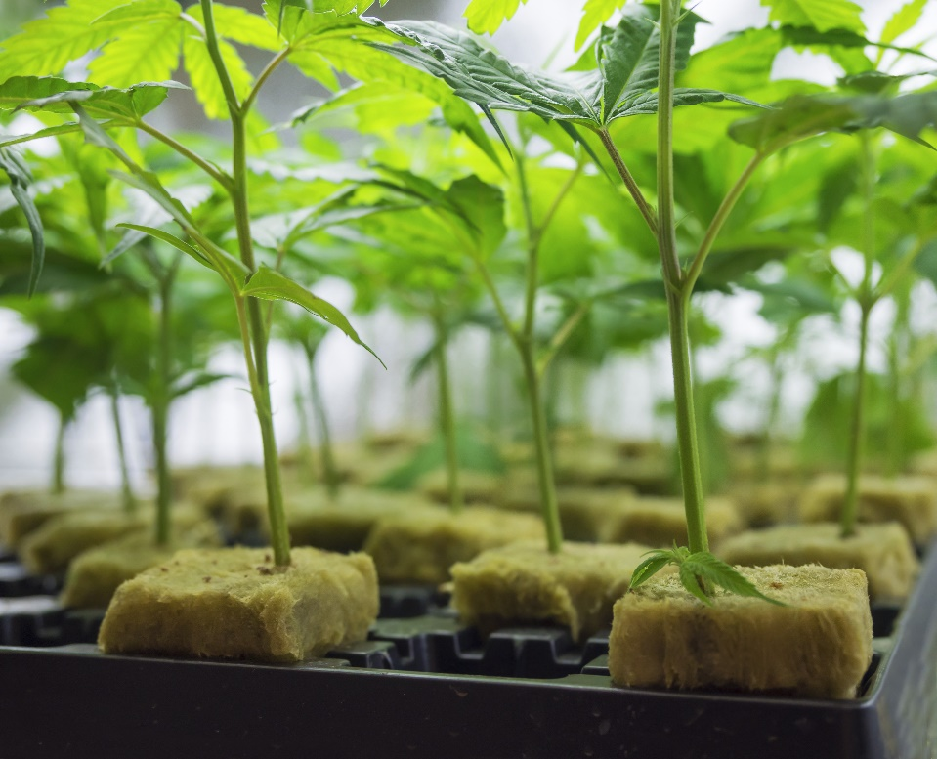
Wholesale Cost – Applicable through December 31, 2022
The wholesale cost is the amount paid by the cannabis retailer for the cannabis or cannabis products including transportation charges.
Notes:
To determine the average market price in an arm’s length transaction, you need to know two things: the cannabis retailer’s wholesale cost of the cannabis or cannabis products and the mark-up rate are determined by CDTFA.
The wholesale cost is the amount paid by the cannabis retailer for the cannabis or cannabis products including transportation charges.

Slide 10
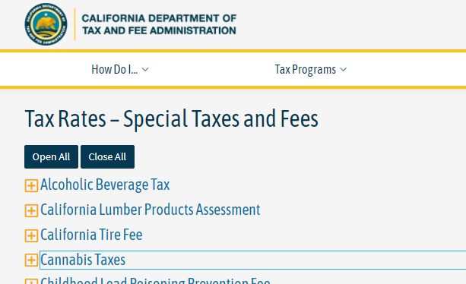
Mark-Up Rate
The current mark-up rate through December 31, 2022, is 75%
Historical rates posted on our website.
Notes:
CDTFA was required to determine the mark-up rate every six months, which applies through December 31, 2022. This rate is only used to compute the average market price of cannabis and cannabis products sold or transferred in an arm’s length transaction. Cannabis retailers may use any mark-up they would like to establish their retail selling price. In an arm’s length transaction, the cannabis excise tax is based on the average market price, not the cannabis retailer’s gross receipts.

Slide 11
Excise Tax Computation
Wholesale cost of flowers $7,500
Mark-up rate ($7,500 x 75%) $5,625
Average market price of flowers $13,125
Total cannabis excise tax due
($13,125 x 15%) $1,968.75
The distributor is responsible for collecting the $1,968.75 cannabis excise tax from the cannabis retailer, reporting it on their cannabis tax return, and paying it to CDTFA.
Notes:
Here is an example of how the cannabis excise tax is calculated through December 31, 2022.
A cannabis retailer purchases five pounds of cannabis flowers for $7,500, in an arm’s length transaction and a distributor transfers the cannabis flowers to that retailer on December 1, 2022. The applicable mark-up rate is 75%. The distributor will apply the markup rate to the wholesale cost paid by the retailer to compute an average market price of $13,125 on this transaction. The 15% excise tax is applied to the average market price of $13,125 to compute the excise tax due of $1,968.75. The distributor is responsible for collecting the $1,968.75 cannabis excise tax from the cannabis retailer, reporting it on their cannabis tax return, and paying it to CDTFA.
This example uses a mark-up rate of 75%, but you must use the rate in effect at the time of sale or transfer of the cannabis or cannabis products by the distributor to the cannabis retailer. The current rate and historical rates can be found on our website on the Special Taxes and Fees Rates Page, under Cannabis Taxes.

Slide 12
Cannabis Excise Tax
Beginning January 1, 2023:
Cannabis excise tax is imposed upon purchasers of cannabis or cannabis products sold in a retail sale.
Cannabis retailers are responsible for collecting the cannabis excise tax from the purchaser.
15% cannabis excise tax will be applied to the gross receipts from the retail sale, rather than the average market price.
Cannabis retailers are responsible for reporting and paying the cannabis excise tax directly to CDTFA for their retail sales made on or after January 1, 2023.
Notes:
For retail sales of cannabis or cannabis products made on and after January 1, 2023:
The cannabis excise tax is imposed on purchasers of cannabis or cannabis products sold in a retail sale.
Cannabis retailers are responsible for collecting the cannabis excise tax from their customers
At a rate of 15% of the gross receipts from the retail sale of cannabis or cannabis products. Please note that this rate is subject to change beginning on July 1, 2025.
Gross receipts include the sales price of the cannabis, after discounts, plus all charges related to the sale, such as delivery fees and any local cannabis business tax listed separately on the receipt to the purchaser.
Gross receipts for cannabis excise tax purposes do not include sales tax or the gross receipts from the retail sale of any non-cannabis item.
Cannabis retailers are responsible for reporting and paying the cannabis excise tax directly to CDTFA for the retail sales made on or after January 1,2023.

Slide 13
Cannabis Excise Tax – Credit for Tax Paid to a Distributor
Beginning January 1, 2023:
Cannabis retailers may claim a credit on their return for any cannabis excise tax paid to a distributor for cannabis or cannabis products purchased before January 1, 2023, and sold at retail on or after January 1, 2023.
Cannabis retailers must keep documentation to support any credits reported on their return.
Sales invoices
Purchase invoices
Any other information supporting the payment of the cannabis excise tax to a distributor
Notes:
Cannabis retailers may claim a credit on their return for any cannabis excise tax paid to a distributor for cannabis or cannabis products purchased before January 1, 2023, and sold at retail on or after January 1, 2023.
Cannabis retailers must keep documentation to support any credits reported on their return. Without proper documentation, the claimed credit may be disallowed. Documentation may include:
Sales invoices indicating the cannabis or cannabis product was sold in a retail sale on and after January 1, 2023,
Purchase invoices indicating the retailer purchased the cannabis that was sold in a retail sale on and after January 1, 2023, was purchased prior to January 1, 2023, and
Any other information supporting the payment of the cannabis excise tax to a distributor for cannabis purchased prior to January 1, 2023, and sold at retail on and after January 1, 2023.

Slide 14
Vendor Compensation
Beginning January 1, 2023, eligible cannabis retailers may apply to retain vendor compensation.
Approval to retain 20% of cannabis excise tax owed on retail sales.
Cannabis retailers must be approved for a DCC fee waiver prior to applying with us.
Online vendor compensation application.
Vendor compensation program ends on December 31, 2025.
Notes:
For your refence and to begin with a general overview of vendor compensation…
Section 34011.1 was the provision added to RTC that allows for eligible cannabis retailers to apply with CDTFA to retain 20% of the cannabis excise tax owed on their retail sales of cannabis or cannabis products.
To be eligible, cannabis retailers must be approved for a DCC equity fee waiver prior to applying with us.
The application is an online only application
The vendor compensation program ends on December 31, 2025.

Slide 15
Vendor Compensation Period
12-month period as long as the cannabis retailer remains eligible
Begins on the first day of the calendar quarter after the date on our vendor compensation approval notice.
Vendor Compensation approval can end prior to the 12-month period if the cannabis retailer does not maintain their eligibility.
Retailers can re-apply with us prior to or after their retention period ends.
Notes:
The retention period will generally be for a 12-month period as long as the cannabis retailer remains eligible for the DCC fee waiver.
The retention period will begin on the first day of the calendar quarter after the date on our vendor compensation approval notice to the retailer. For example, a team member approves an application on January 18, 2023, then the retention period will begin on April 1, 2023.
Cannabis retailers must re-apply with us to retain vendor compensation prior to or after their approved retention period ends.

Slide 16
Retain Vendor Compensation
Applies only to the retail sales made at the retail location approved for vendor compensation.
Vendor compensation cannot be retained on any retail sales made if the cannabis retailer license is expired or revoked or if the sales were made under any other cannabis license that the retailer may have.
The return will automatically calculate 20% of the excise tax due on sales reported for the location approved for vendor compensation.
Notes:
The excise tax retained for vendor compensation must be collected on sales made under the retailer license that was approved by DCC for a fee waiver.
Vendor compensation cannot be retained on any retail sales made if the cannabis retailer license is expired or revoked or if the sales were made under any other cannabis license that the retailer may have.
The retailer will be required to report their retail sales made for each location registered under their account. The return will automatically calculate 20 percent of the cannabis excise tax due on the sales reported for the location approved for vendor compensation.

Slide 17
Gross Receipts
Regulation 3802 was approved in January 2024 and provides additional guidance and clarity regarding gross receipts subject to the excise tax.
A new Tax Fact will be issued covering the topic of gross receipts.
Notes:
The excise tax retained for vendor compensation must be collected on sales made under the retailer license that was approved by DCC for a fee waiver.
Vendor compensation cannot be retained on any retail sales made if the cannabis retailer license is expired or revoked or if the sales were made under any other cannabis license that the retailer may have.
The retailer will be required to report their retail sales made for each location registered under their account. The return will automatically calculate 20 percent of the cannabis excise tax due on the sales reported for the location approved for vendor compensation.

Slide 18
Cannabis Excise Tax Example
Example of tax calculation beginning January 1, 2023
Selling price of cannabis $35.00
Cannabis business tax (10% x $35) $3.50
Delivery fee + $5.00
Subtotal ($35 + $3.50 + $5) $43.50
Excise tax (15% x $43.50) $6.53
Sales tax calculation:
Subtotal ($43.50 + $6.53) $50.03
Sales tax due (8.5% x $50.03) + $4.25
Total due from customer ($50.03 + $4.25) $54.28
Notes:
Before we move on, here is an example of how the cannabis excise tax will be calculated for all retail sales of cannabis or cannabis products made on and after January 1, 2023.
A cannabis retailer sells cannabis for $35 to a purchaser to deliver to the purchaser for a $5 delivery fee.
There is also a 10% local business tax. Please be sure to check with your local jurisdiction for guidance on how the local business tax shall be calculated and the current rate.
The local business tax listed separately on the receipt and the delivery fee are included in gross receipts when calculating the cannabis excise tax and sales tax due.
For this example, the excise tax due based on gross receipts is $6.53.
The $6.53 in excise tax is then included in gross receipts to calculate the sales tax due.
For this example, the assumed sales tax rate is 8.5% and is applied to the total gross receipts of $50.03 to calculate $4.25 sales tax due.
Please be sure to use the sales tax rate in effect at the time of sale for your location.
Current sales tax and excise tax rates can be found on our website.

Slide 19
Requirements for Cannabis Retailers
Register for a seller’s permit.
Beginning January 1, 2023, cannabis retailers must file cannabis retailer excise tax returns online and pay the15% cannabis excise tax due to CDTFA.
Report and pay use tax on taxable items purchased without tax and used by the retailer (for example, inventory items used for display).
Notes:
Now that we have gone over how tax applies to cannabis and cannabis products, we will now move on to your requirements with CDTFA for registering, filing returns, and record keeping.
Cannabis retailers are required to:
Register for a seller’s permit.
Report sales and pay the sales tax due to CDTFA
Report and pay use tax on taxable items purchased without tax and used by the retailer, for example, when a retailer uses an inventory item for display.
Beginning January 1, 2023, retailers must register for a cannabis retailer excise tax permit and report and pay the 15 percent cannabis excise tax to CDTFA.

Slide 20
Requirements for Cannabis Retailers (continued)
Collect the cannabis excise tax from purchasers and provide a receipt or invoice to the customer:
Beginning January 1, 2023, the cannabis excise tax must be listed separately on the receipt.
For retail sales of cannabis or cannabis products made on and after January 1, 2023, retailers must report and pay cannabis excise tax directly to CDTFA.
Notes:
Cannabis retailers are also required to collect the cannabis excise tax from their customers. Along with providing the customer with a receipt or invoice:
On and after January 1, 2023, the cannabis excise tax must be listed separately on the receipt or invoice.
For retail sales of cannabis or cannabis products made on and after January 1, 2023, retailers must report and pay the cannabis excise tax directly to CDTFA.
It is important that cannabis retailers keep accurate records of their business activities and make sure to obtain the appropriate business licenses. Cannabis retailers will need to obtain a retail license from the Department of Cannabis Control. Additionally, many local governments have licensing requirements for the cannabis industry, so retailers should make sure to contact their city and county government offices for information on local licenses.

Slide 21
Requirements for Cannabis Cultivators, Manufacturers and Distributors
Register for a seller’s permit.
Obtain resale certificates.
File sales and use tax returns.
Report and pay use tax on taxable items purchased without tax and used.
Keep adequate records.
Obtain the appropriate licenses for your business.
Notes:
Cannabis cultivators and manufacturers are required to:
Register for a seller’s permit
Obtain resale certificates
File sales and use tax returns
Report and pay use tax on taxable items purchased without tax and used
Cultivators and manufacturers must keep accurate records of their commercial cannabis business activities and ensure they obtain the appropriate business licenses. The Department of Cannabis Control is responsible for issuing commercial cannabis cultivator and manufacturer licenses; however, there may be other local government licensing requirements.

Slide 22
Recordkeeping Requirements for the Cannabis Industry
Every sale or transport of cannabis or cannabis products from one licensee to another must be recorded on a sales invoice or receipt. Each sales invoice or receipt must include:
Names and addresses of the seller and purchaser,
Date of sale,
Invoice number,
Kind, quantity, size, and capacity of packages of cannabis or cannabis products sold,
Notes:
The Medicinal and Adult-Use Cannabis Regulation and Safety Act requires a licensee authorized to engage in commercial cannabis activity to keep accurate records of commercial cannabis activity for a minimum of seven years. For example, every sale or transport of cannabis or cannabis products from one licensee to another must be recorded on a sales invoice or receipt.
Each sales invoice or receipt must include:
Names and addresses of the seller and purchaser
Date of sale,
Invoice number,
Kind, quantity, size, and capacity of packages of cannabis or cannabis products sold,

Slide 23
Recordkeeping Requirements for the Cannabis Industry (continued)
Cost to the purchaser, including any discount applied to the price shown on the invoice,
Place from which the cannabis or cannabis products were transported from unless the transport was made from the premises of the licensee.
Any other information as required.
Notes:
The sales invoice or receipt must also include:
The cost to the purchaser, including any discount applied to the price shown on the invoice.
The location of transport of the cannabis or cannabis product unless the transport was from the licensee's location, like when a licensee uses a 3rd party transporter.
Any other information as required by CDTFA, Department of Cannabis Control, or other relevant authority.

Slide 24
50 Percent (50%) Penalty for Late Payment of Cannabis Taxes
The Cannabis Tax Law imposes a mandatory 50 percent penalty for failure to pay the cannabis taxes when due.
If you fail to pay the cannabis taxes by your due date, you may be relieved of the 50 percent penalty if you file a request for relief and if CDTFA finds that your failure to timely pay was due to reasonable cause and circumstances beyond your control.
You may request relief of penalty by visiting our Online Services page at www.cdtfa.ca.gov/services/ and following the directions under the Request Relief tab.
Notes:
The cannabis tax law imposes a mandatory 50 percent penalty for not paying the cultivation tax or cannabis excise tax when they are due.
If you do not pay the cannabis taxes by your due date, you may be relieved of the 50 percent penalty if you file a request for relief and if CDTFA finds that did not pay timely due to a reasonable cause and circumstances beyond your control and occurred notwithstanding the exercise of ordinary care and absence of willful neglect.
You may request relief of penalty by visiting our Online Services page and follow the directions under the Request Relief tab.

Slide 25
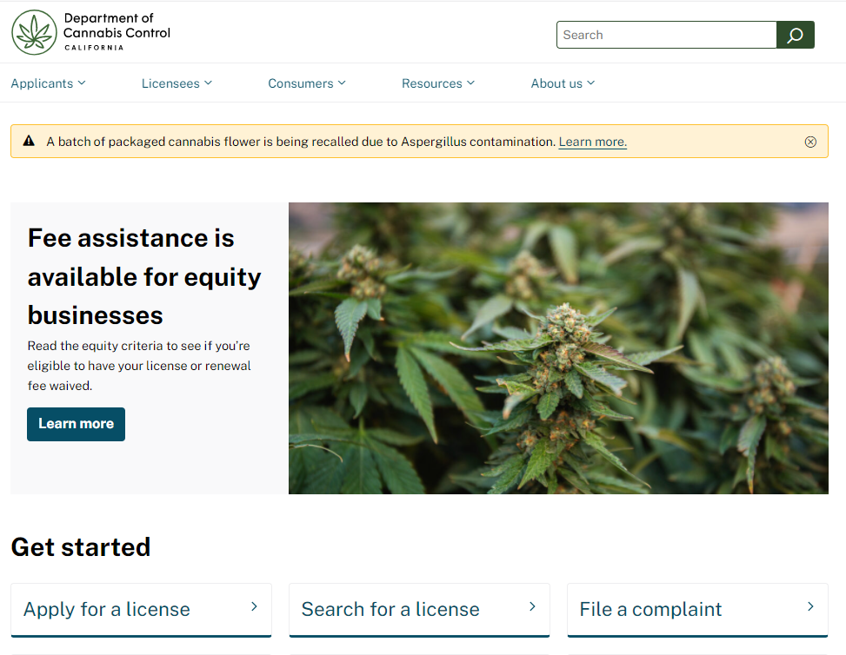
Department of Cannabis Control
www.cannabis.ca.gov/
Notes:
The Department of Cannabis Control is responsible for issuing state cannabis licenses for all cannabis commercial activities.

Slide 26
Customer Service Center
Customer service representatives can walk you through your tax return or the registration process, as well as answer your general tax questions.
1-800-400-7115
CRS:711 for the hearing and speech impaired
Monday–Friday from 7:30 a.m. to 5:00 p.m. (Pacific time), except state holidays.
24-hour voice recordings on specific topics.
Notes:
Core point to convey
There are many ways to obtain information and help - online, by appointment, by phone, and social media.
Customer Service Center: 1-800-400-7115 (CRS: 711), Monday through Friday, 7:30 a.m. to 5:00 p.m. (Pacific time), except state holidays.

Slide 27
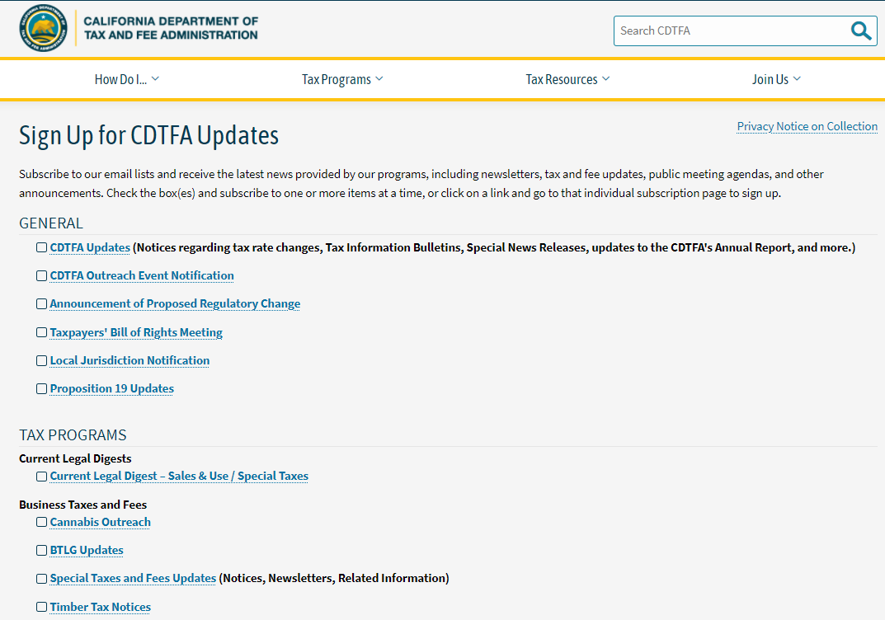
Sign Up for CDTFA Updates
www.cdtfa.ca.gov/subscribe/
Notes:
You can receive the latest news provided by our programs, including newsletters, tax and fee updates, public meeting agendas, and other announcements by subscribing to our email lists at https://www.cdtfa.ca.gov/subscribe/. You can sign up to receive updates via email to one or more programs or topics provided on this page.
To receive specific information relating to the cannabis industry, select Cannabis Outreach check box under the Tax Programs section, Business Taxes and Fee sub-heading.

Slide 28
Taxpayers’ Rights Advocate
1-888-324-2798
If you are unable to resolve any tax issues through normal channels with CDTFA or if you would like more information regarding your rights, contact the Taxpayers’ Rights Advocate Office at www.cdtfa.ca.gov/tra/.
Notes:
Core point to convey
Provides resolutions on any tax issues you may have with CDTFA or if you want to know about your rights.
Taxpayers’ Rights Advocate phone number 1-888-324-2798
Taxpayers’ Rights Advocate link: www.cdtfa.ca.gov/tra/
Resources:
Publication 70, Understanding Your Rights as a California Taxpayer
Search www.cdtfa.ca.gov

